Slide 1
An Introduction to Feature
Selection/Scaling

Slide 2
Feature Extraction
In practice, data rarely comes in the form of ready-to-use matrices. That's why every task begins with feature extraction.
Let's look at some of the popular types of data from which features can be extracted.
  Texts
  Images
  Geospatial data
  Date and time
  Time series, web, etc.

Slide 3
Feature Selection
  Thousands to millions of low level features: select the most relevant one to build better, faster, and easier to understand learning machines.
n
n’
X
m

Slide 4
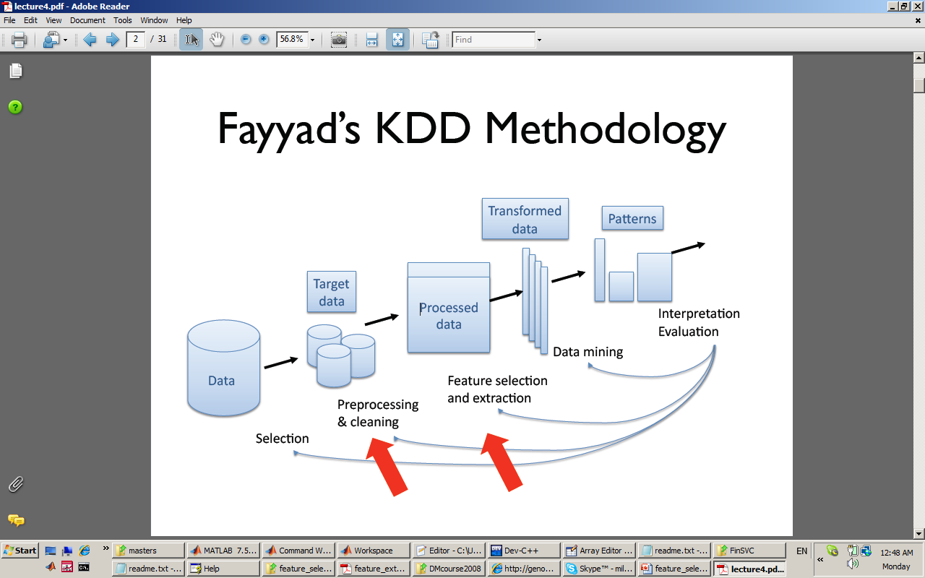
Feature Selection, Dimensionality Reduction, and Clustering in the KDD Process
U.M.Fayyad, G.Patetsky-Shapiro and P.Smyth (1995)
<number>/54

Slide 5
Feature Selection
Which features should you use to create a predictive model?
  This is a difficult question that may require deep knowledge of the problem domain.
It is possible to automatically select those features in your data that are most useful or most relevant for the problem you are working on. This is a process called feature selection.

Slide 6
What is Feature Selection?
Feature selection is also called variable selection or attribute selection.
It is the automatic selection of attributes in your data (such as columns in tabular data) that are most relevant to the predictive modeling problem you are working on.
“feature selection… is the process of selecting a subset of relevant features for use in model construction”

Slide 7
What is Feature Selection?
Feature selection is different from dimensionality reduction.
Both methods seek to reduce the number of attributes in the dataset, but a dimensionality reduction method do so by creating new combinations of attributes, where as feature selection methods include and exclude attributes present in the data without changing them.
Examples of dimensionality reduction methods include Principal Component Analysis, Singular Value Decomposition and Sammon’s Mapping.
“Feature selection is itself useful, but it mostly acts as a filter, muting out features that aren’t useful in addition to your existing features.”
— Robert Neuhaus,

Slide 8
The Problem The Feature Selection Solves
Feature selection methods aid you in your mission to create an accurate predictive model.
They help you by choosing features that will give you as good or better accuracy whilst requiring less data.
Feature selection methods can be used to identify and remove unneeded, irrelevant and redundant attributes from data that do not contribute to the accuracy of a predictive model or may in fact decrease the accuracy of the model.
“The objective of variable selection is three-fold: improving the prediction performance of the predictors, providing faster and more cost-effective predictors, and providing a better understanding of the underlying process that generated the data.”
— Guyon and Elisseeff

Slide 9
Feature Selection Algorithms
There are three general classes of feature selection algorithms: filter methods, wrapper methods and embedded methods.
  Filtering approach:
  ranks features or feature subsets independently of the predictor (classifier).
    …using univariate methods: consider one variable at a time
    …using multivariate methods: consider more than one variables at a time
  Wrapper approach:
  uses a classifier to assess (many) features or feature subsets.
  Embedding approach:
  uses a classifier to build a (single) model with a subset of features that are internally selected.

Slide 10
Filter Methods
Filter feature selection methods apply a statistical measure to assign a scoring to each feature.
The features are ranked by the score and either selected to be kept or removed from the dataset.
The methods are often univariate and consider the feature independently, or with regard to the dependent variable.
Some examples of some filter methods include the Chi squared test, information gain and correlation coefficient scores.

Slide 11
Wrapper Methods
Wrapper methods consider the selection of a set of features as a search problem, where different combinations are prepared, evaluated and compared to other combinations.
A predictive model us used to evaluate a combination of features and assign a score based on model accuracy.
The search process may be methodical such as a best-first search, it may stochastic such as a random hill-climbing algorithm, or it may use heuristics, like forward and backward passes to add and remove features.
An example if a wrapper method is the recursive feature elimination algorithm.

Slide 12
Embedded Methods
Embedded methods learn which features best contribute to the accuracy of the model while the model is being created.
The most common type of embedded feature selection methods are regularization methods.
Regularization methods are also called penalization methods that introduce additional constraints into the optimization of a predictive algorithm (such as a regression algorithm) that bias the model toward lower complexity (fewer coefficients).
Examples of regularization algorithms are the LASSO, Elastic Net and Ridge Regression.

Slide 13
Feature Scaling
Feature scaling can vary your results a lot while using certain algorithms and have a minimal or no effect in others.
To understand this, let’s look why features need to be scaled, varieties of scaling methods and when we should scale our features.

Slide 14
Why Scaling?
Most of the times, your dataset will contain features highly varying in magnitudes, units and range.
But since, most of the machine learning algorithms use Euclidian distance between two data points in their computations, this is a problem.
If left alone, these algorithms only take in the magnitude of features neglecting the units. The results would vary greatly between different units, 5kg and 5000gms.
The features with high magnitudes will weigh in a lot more in the distance calculations than features with low magnitudes.
To supress this effect, we need to bring all features to the same level of magnitudes. This can be acheived by scaling.

Slide 15
How to Scale Features?
There are four common methods to perform Feature Scaling.
  Standardization
  Mean Normalization
  Min-Max Scaling
  Unit Vector

Slide 16

Standardization
Standardization replaces the values by their Z scores.
This redistributes the features with their mean μ = 0 and standard deviation σ =1 . sklearn.preprocessing.scale helps us implementing standardization in python.

Slide 17

Mean Normalization
This distribution will have values between -1 and 1 with μ=0.
Standardization and Mean Normalization can be used for algorithms that assumes zero centric data like Principal Component Analysis(PCA).

Slide 18

Min-Max Scaling
This scaling brings the value between 0 and 1

Slide 19

Unit Vector
Scaling is done considering the whole feature vector to be of unit length.
Min-Max Scaling and Unit Vector techniques produces values of range [0,1]. When dealing with features with hard boundaries this is quite useful.
For example, when dealing with image data, the colors can range from only 0 to 255.

Slide 20
When to Scale?
Rule of thumb, follow if there is any algorithm that computes distance or assumes normality, scale your features!!!
Some examples of algorithms where feature scaling matters are:
  k-nearest neighbors with an Euclidean distance measure is sensitive to magnitudes and hence should be scaled for all features to weigh in equally.
  Scaling is critical, while performing Principal Component Analysis(PCA). PCA tries to get the features with maximum variance and the variance is high for high magnitude features. This skews the PCA towards high magnitude features.
  We can speed up gradient descent by scaling. This is because θ will descend quickly on small ranges and slowly on large ranges, and so will oscillate inefficiently down to the optimum when the variables are very uneven.

